Slide 1
Polymerase Chain Reaction
PCR

Slide 2
PCR
invented by Karry B. Mullis (1983, Nobel Prize 1993)
patent sold by Cetus corp. to La Roche for $300 million
depends on thermo-resistant DNA polymerase (e.g. Taq polymerase) and a thermal cycler

Slide 3
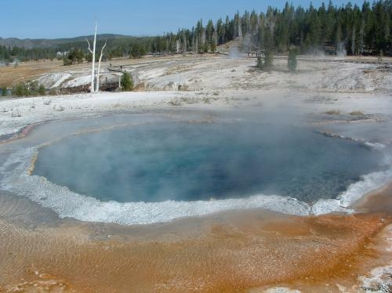
Heat-stable DNA polymerase
Taq DNA polymerase was isolated from the bacterium Thermus aquaticus.
Taq polymerase is stable at the high temperatures (~95ºC) used for denaturing DNA.
Hot springs at Yellowstone
National Park, Wyoming.

Slide 4
DNA polymerase requirements
template
primer
nucleotides
regulated pH, salt concentration, cofactors

Slide 5
Steps in DNA replication
template denatured
primers anneal
new strand elongation

Slide 6
Steps in a PCR cycle
1) template denatured:
94 C, 30 sec
2) primers anneal
45-72 C, depending on primer sequence
30 sec – 1 min
3) new strand elongation
72 C depending on the type of polymerase
1 min for 1000 nucleotides of amplified sequence
Number of specific DNA molecule copies grows exponentially with each PCR cycle. Usually run 20-40 cycles to get enough DNA for most applications (If you start with 2 molecules, after 30 cycles you will have more than a billion)

Slide 7
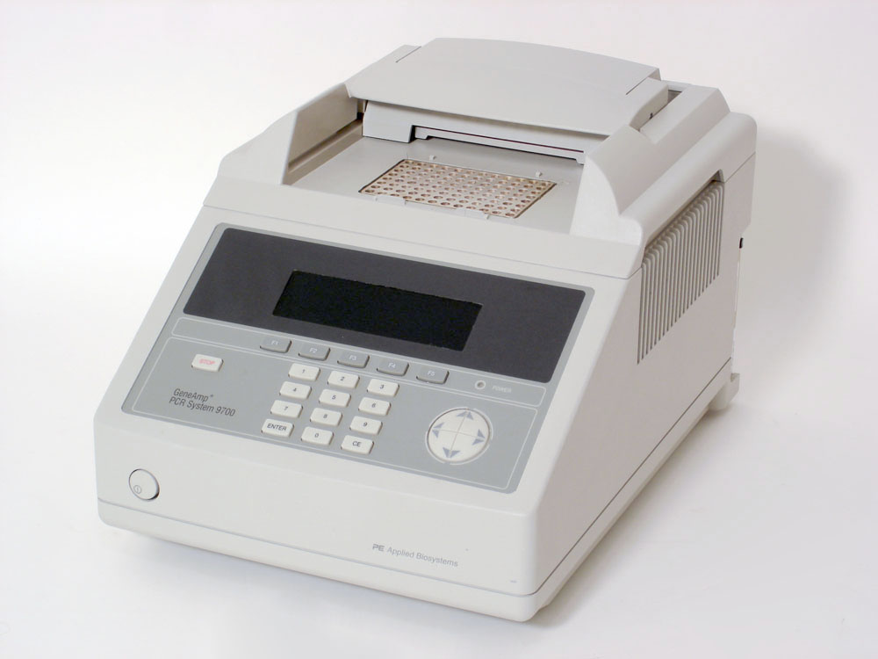
PCR Process
25-30 cycles
2 minute cycles
DNA thermal cycler
Notes:
-For most cases the PCR process will undergo about 25-30 cycles which will produce about 1 million copies of DNA that a scientist can perform other tests on.
-Since each cycle is about 2 minutes long, it takes about an hour to reproduce 1 million copies of DNA.
-The whole process of PCR takes place in a DNA thermal cycler which is pictured here.

Slide 8
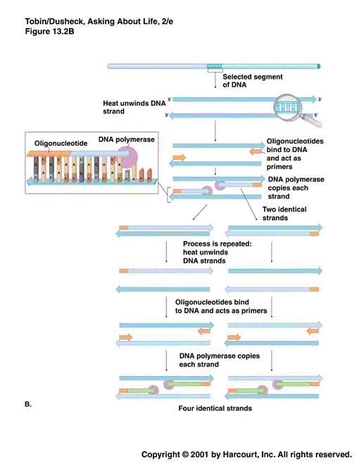
Template denatured
Annealing primers
New strand elongation

Slide 9
Uses for PCR
Research
Gene cloning
Real-time PCR
DNA sequencing
Clinical
DNA fingerprinting
Crime scene analysis
Paternity testing
Archeological finds
Genetically inherited diseases

Slide 10
The PCR can be used as an alternative to hybridization for the screening of genomic and cDNA libraries

Slide 11
There are also several applications where the use of degenerate primers is favorable. A degenerate primer is a mixture of primers, all of similar sequence but with variations at one or more positions.

Slide 12
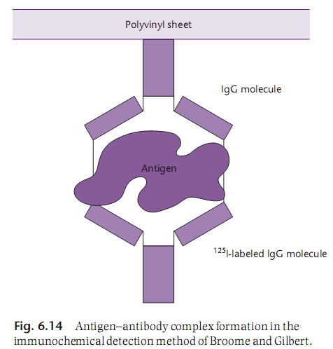
Immunological screening uses speciﬁc antibodies to detect expressed gene products

Slide 13
Southwestern and northwestern screening are used to detect clones encoding nucleic acid binding proteins

Slide 15
Functional cloning exploits the biochemical or physiological activity of the gene product

Slide 16
